Slide 1

Club + Hobby
A Social Hobby Platform made by Teletabist

Slide 2
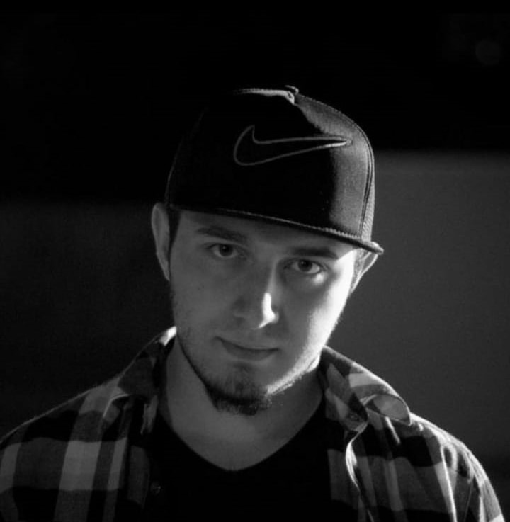
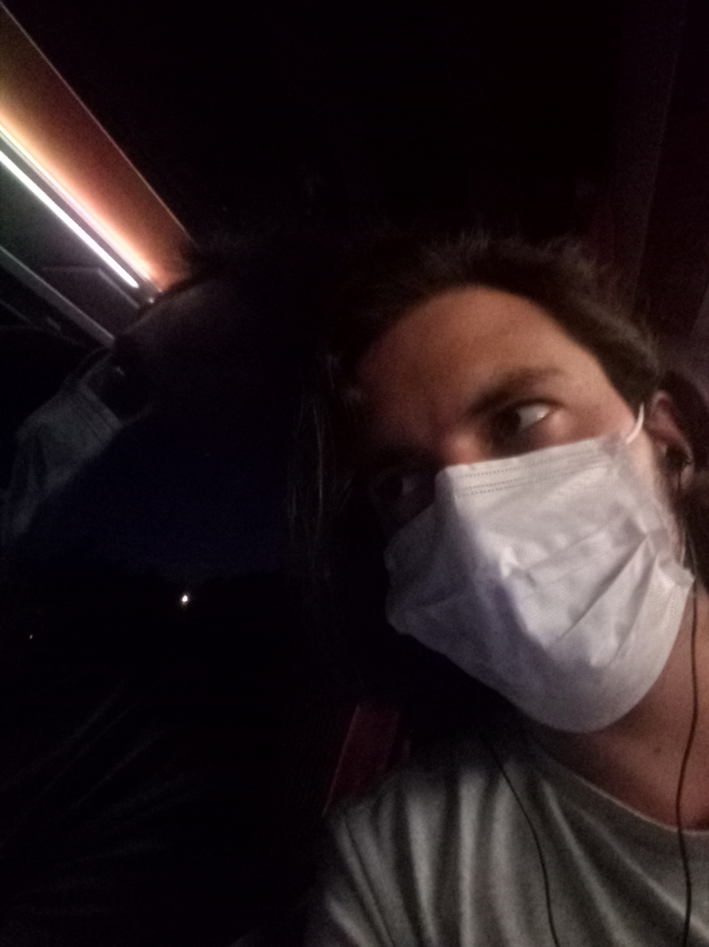
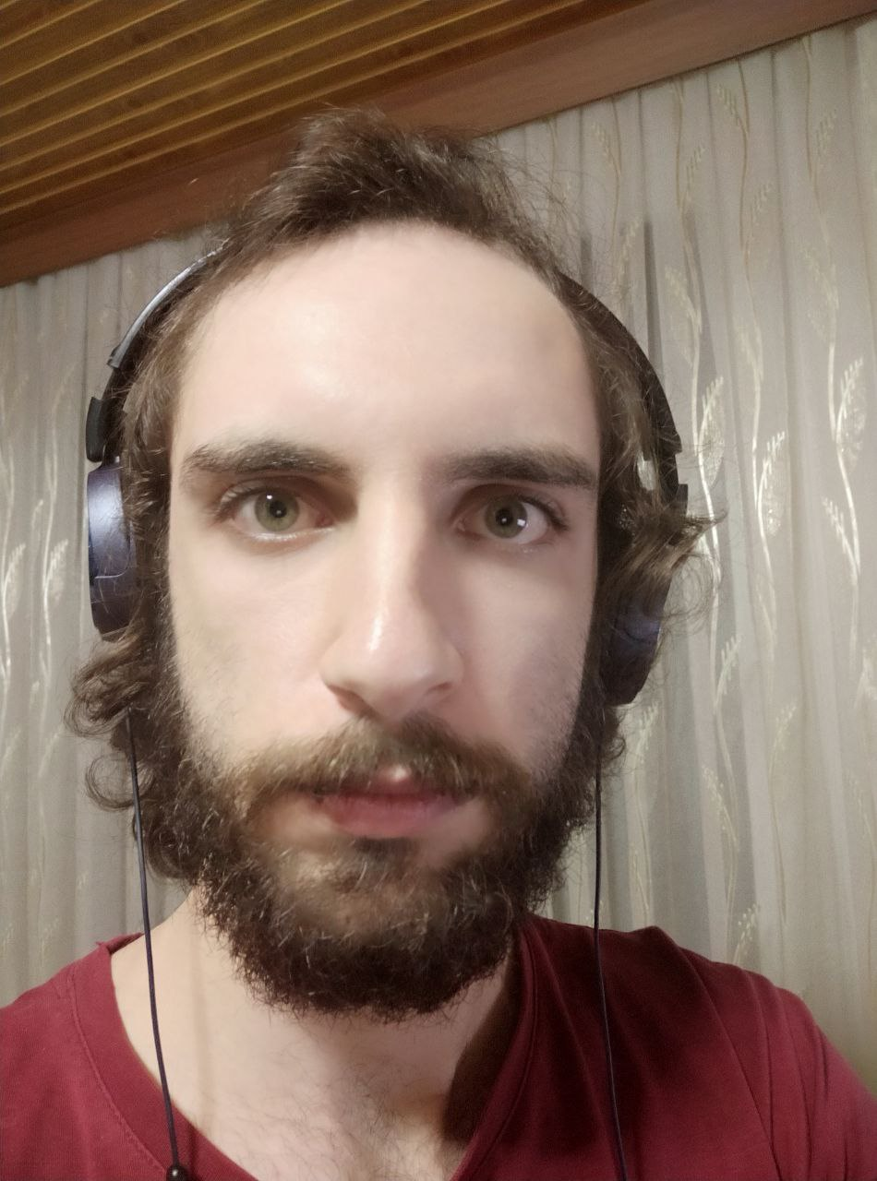
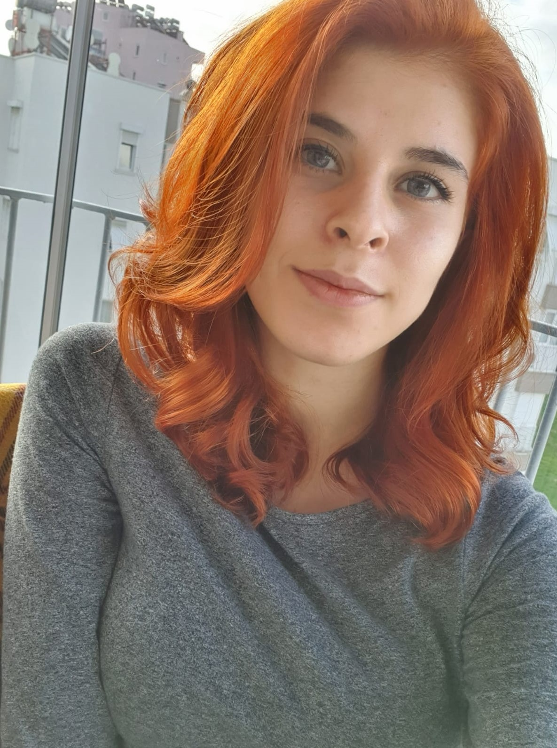
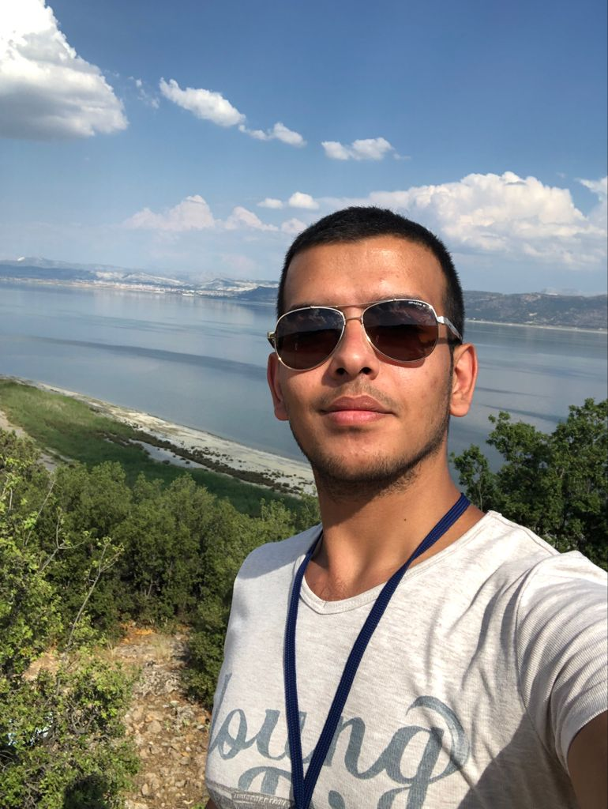
Meet with the Teletabists
Osman Yiğit Koç
21803677
Project Manager
Full Stack Developer
System Design
İlker Emre Koç
21827608
Software Architect
Backend Developer
Document Analysis
Eren Kumru
21727518
Software Analyst
Backend Developer
System Analysis
Berra Nur Sarı
21727671
Software Configuration Manager
Frontend Developer
UI Design
Abdil Buğra Ünal
21527506
Software Tester
Backend Developer
Quality Assurance

Slide 3
Yiğit
Main Role: Project Manager
Side Role: Software Developer
Specialties: Full Stack Developer, System Design
Main Tasks: Team Management, Product Management, Milestone Management, System Engineer
Documents: Vision (Partly), Project Plan, Software Requirements Specification (Partly), Software Design Document
Works: Backend Development; Main Module, Admin Module, Survey Module, Search, User, Tickets; Frontend Development; Co-op Complete Development

Slide 4

İlker
Main Role: Software Architect
Side Role: Software Developer
Specialties: Backend Developer, Document Analysis
Main Tasks: Architectural Design, Technology Identification, Software Specification Definition, Design Advisor, Document Editor
Documents: Vision (Partly), Software Requirements Specification, Architectural Notebook, List of Test Case Requirements (Partly), Risk Management Report (Partly), Software Design Document (Partly), Coding Standard, Updated Documents
Works: Backend Development; Club, Club-Member, Survey, Banning Modules; Sequence Diagrams

Slide 5
Eren
Main Role: Software Analyst
Side Role: Software Developer
Specialties: Backend Developer, Product Analysis
Main Tasks: Product Identification, Use Case Definition, Requirements Analysis, System Analysis, Stakeholder Management & Communication
Documents: Experiment Sheet Design Notes (Internal), Vision, Use Case Definition, Software Requirements Specification, Software Design Document (Partly)
Works: Backend Development; Club Comment, Club Discussion, Event Module; Use Case Definitions, Use Case Diagrams, Activity Diagrams, Sequence Diagrams, Survey Questions & Answers

Slide 6
Berra
Main Role: Software Configuration Manager
Side Role: Software Developer
Specialties: Frontend Developer, UI Design
Main Tasks: Product Version Control, Configuration Management, (GUI) Environment Establishment
Documents: Graphical User Interface Design, Configuration and Change Management Report
Works: Frontend Development; Co-op Complete Development

Slide 7
Buğra
Main Role: Software Tester
Side Role: Software Developer
Specialties: Backend Developer, Quality Assurance
Main Tasks: Quality Testing, Software Analysis, Bug Reports, Verification and Validation
Documents: List of Test Cases, Software Test Report
Works: Backend Development; Profile Module, Discussion Module, User Module

Slide 8


Task Management and Version Management

Slide 9









Technologies

Slide 10

Thank You

